Slide 1
TEAM NAME : Techtonics
Intel products sentiments analysis from online reviews

Slide 2
Problem Statement
Intel products sentiments analysis from online reviews
The objective of this project is to analyze online reviews of Intel products to understand customer sentiments and opinions. By employing natural language processing (techniques and sentiment analysis, this project aims to categorize the reviews into various sentiment categories (positive, negative, future expectations and competition sentiments) and extract insights related to customer satisfaction, common issues, and expectations.

Slide 3
Unique Idea Brief (Solution)
We have categorized the reviews into four sentiments: positive, negative, future expectations, and competition sentiments.
We have labelled all the user reviews from the dataset manually and also with the help of chatGPT
We have implemented ensemble techniques which involves combining predictions from multiple base models to enhance overall performance. We used both stacking and voting to combine different models' strengths for more accurate sentiment predictions.(Base model:Random Forest, Meta model: Logistic regression)
We have incorporated the Llama 3 8B model, to improve our accuracy, leveraging its scalability in handling large datasets and efficiency in training processes.
Furthermore, we tried implementing Mistral 8x 7B but we could not implement it due to lack of GPU resources in free version of Colab.

Slide 4
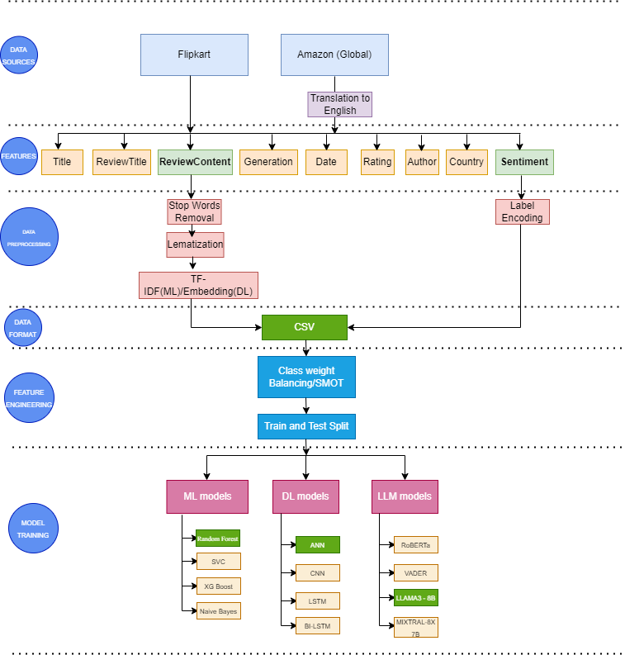
Process Flow

Slide 5
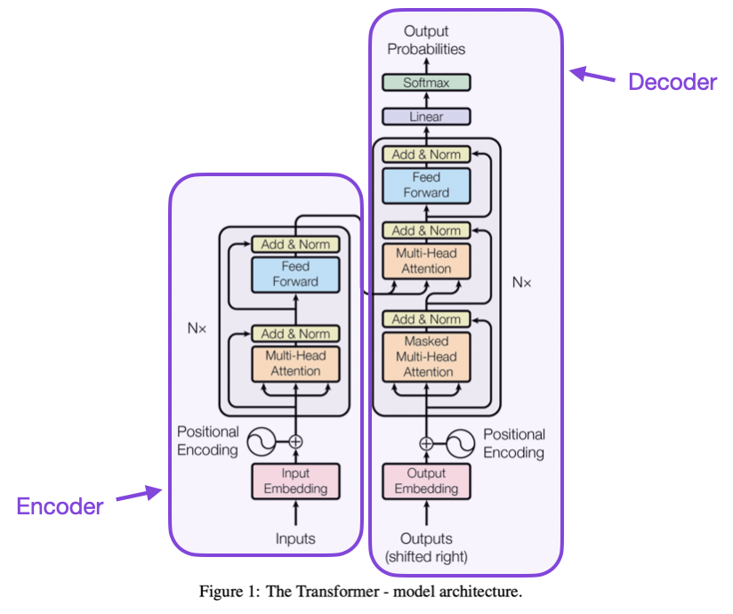
Architecture Diagram
This is the architecture of Llama 3 model which gives best accuracy (0.76)

Slide 6
Technologies Used
Natural Language Processing (NLP) Techniques
Focus on tokenization to break text into meaningful units
Text vectorization methods such as TF-IDF to transform text into numerical representations that machine learning models can process
Machine Learning (ML) Techniques
Supervised Learning Algorithms
Support Vector Machines (SVM)
Random Forests
Naive Bayes
XGBoost
Unsupervised Learning Algorithms
Clustering - K-means
Deep Learning Models
Convolutional Neural Networks (CNNs)
Artificial Neural Networks (ANNs)
Long Short Term Memory (LSTM)
LLMs
Llama 3 8B/Mistral 7B
RoBERTa/VADER
These models are trained on labeled datasets to classify reviews into sentiment categories

Slide 7
Sentiment Analysis Libraries
NLTK (Natural Language Toolkit) provides pre-built functionalities and tools for text processing and analysis
Data Preprocessing Steps
Cleaning and normalizing text data
Removing noise such as punctuation and stopwords (common words with little semantic meaning)
Performing text normalization to ensure consistency and improve model accuracy
Evaluation Metrics
Accuracy
Precision
Recall
F1-score
These metrics are used to assess the performance of sentiment analysis models, measuring how well the models predict sentiment labels
Hyperparameter Tuning
Involves optimizing various parameters to enhance the performance and accuracy of machine learning models used for sentiment classification
This process is crucial for ensuring that the models effectively capture and classify sentiment from textual data

Slide 8
Key Summary and Recommendation:
Project Overview:
Objective: Perform sentiment analysis on Intel product reviews from e-commerce platforms.
Scope: Data scraping, data preparation, exploratory data analysis (EDA), model training, and evaluation.
Sentiment Categories: Positive, Negative, Competition Sentiment, Future Expectation.
Data Collection and Preparation:
Data Sources: Amazon and Flipkart.
Data Cleaning: Removal of stopwords, punctuation, and lemmatization.
Feature Extraction: Vectorization of review content using TF-IDF.
Label Encoding: Encoding sentiments into four categories (0, 1, 2, 3).
Exploratory Data Analysis (EDA):
Insights: Distribution of sentiments, common keywords, and trends over time.
Visualizations: Sentiment distribution charts, word clouds, and time series plots.

Slide 9
Model Training and Evaluation:
Machine Learning Models: SVC, RandomForest, XGBoost, Naive Bayes.
Hyperparameter Tuning: RandomizedSearchCV and GridSearchCV.
Deep Learning Models: Fine-tuning Llama 3 model.
Performance Metrics: Accuracy, Precision, Recall, F1-Score.
Handling Imbalanced Data: SMOTE and class weight balancing.
Cross-Validation: Stratified k-fold cross-validation for robust evaluation.
Ensemble Methods:
Stacking: RandomForest as base model, Logistic Regression as meta model.
Voting: Voting classifier with RandomForest.
Done along with cross validation

Slide 10
RECOMMENDATIONS(based on all the reviews analysed):
Address Heating Issues.
Develop better cooling solutions and improve thermal design.
Provide user guidelines for managing heating.
Resolve Crashing Problems
Release regular firmware updates.
Implement robust bug tracking and perform extensive stress testing.
Minimize Hanging Issues
Optimize performance for multitasking.
Ensure software compatibility and provide diagnostic tools.
General Improvements
Establish a continuous feedback loop with customers.
Enhance customer support services.
Increase quality assurance rigor.
Maintain transparency about known issues and resolutions.

Slide 11
Team members and contribution:
Shamsu Nisha. N(Leader)
Labelling the reviews manually
Made the report
Made the PPT
Arjun B
Data Scraping from e-commerce websites
Did “Exploratory Data Analysis”
Preparing the data for modelling(preprocessing, cleaning, tokenization etc)
Prepared the codes and tested all the models(Supervised ML, DL, and LLMs, and also Ensembling models)
Set up the coding environment and took care of whole coding and testing.
Took care of the full project flow

Slide 12
Team members and contribution:
Gurumani Akash. S
Clustering
Vader
Creating py files from ipynb notebooks for ML models.
Anirudhan
Scrapping extra reviews
Tharani. VS
Researching on the technologies required for the project and helping the team members with updates.
MENTOR: S.R. Senthil Kumar,Assistant Professor CSE
INSTITUTION: B.S.Abdur Rahman Crescent Institute of Science and Technology

Slide 13
Conclusion
This project employs machine learning, deep learning, LLM models, and ensemble techniques to analyze customer sentiments from online reviews of Intel products. Evaluating the performance of various models including machine learning, deep learning, LLM models, and ensemble techniques to determine their accuracy in analyzing sentiments. Doing this project helped us to learn a lot, and it was a great experience. We would like to thank the organisers, our Intel mentors and the whole team and Intel, for organising and conducting the Intel Unnati Industrial Training Program 2024 successfully, and giving us a chance to participate in this wonderful program!

